Slide 1

IBM Watson Dialog & NLC
Norman Kung

Slide 2

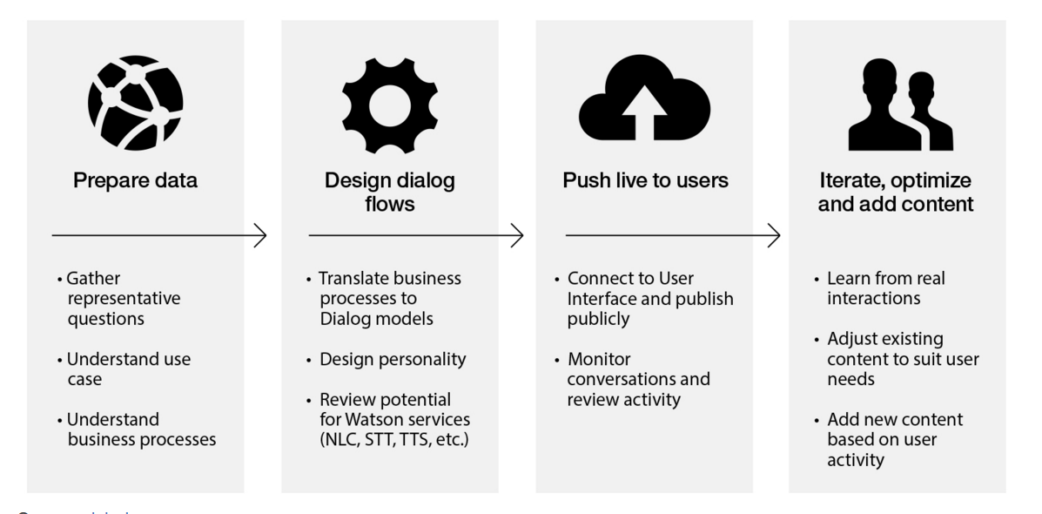
Dialog Service

Slide 3
How to use?
Build your own XML script
Deploy on the dialog tool to test
Implement on your real project

Slide 4
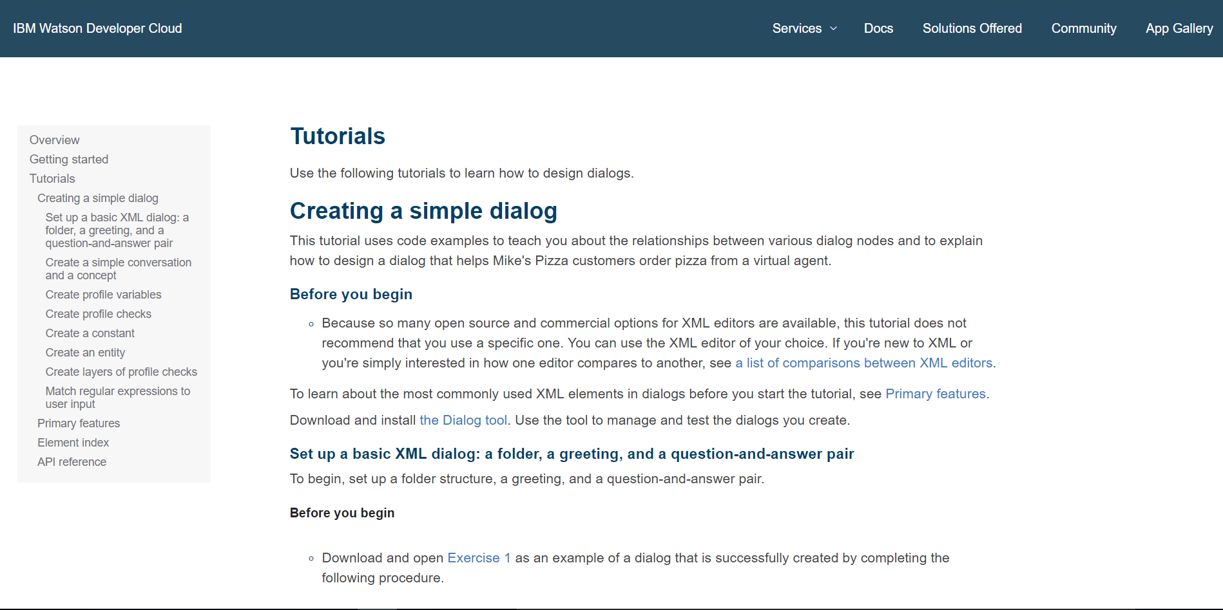
Tutorial

Slide 5
XML script
https://github.com/as93717913/face

Slide 6
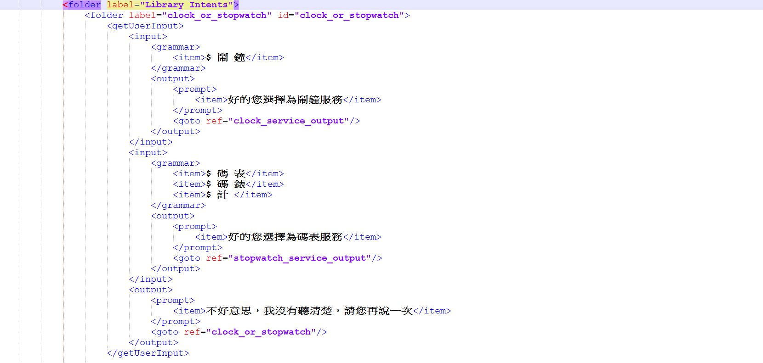
XML script

Slide 7
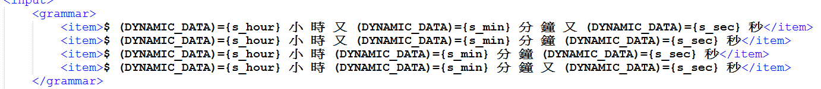
XML script

Slide 8
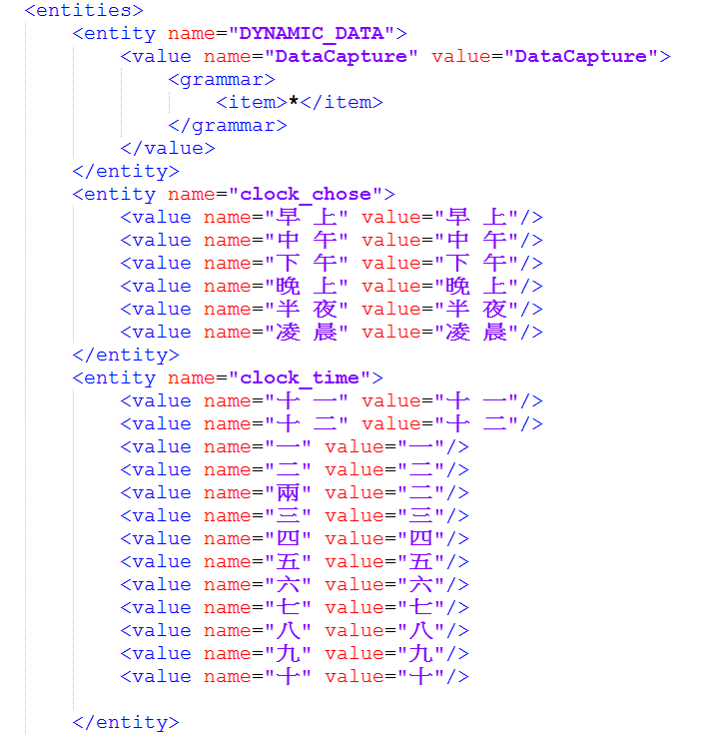
XML script

Slide 9
Deploy on the dialog tool to test
https://github.com/watson-developer-cloud/dialog-tool

Slide 10

Deploy on the dialog tool to test

Slide 11
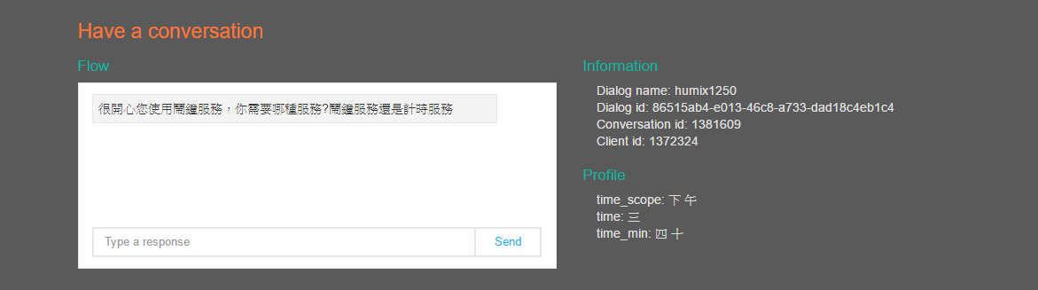
Deploy on the dialog tool to test

Slide 12
Deploy on the dialog tool to test

Slide 13
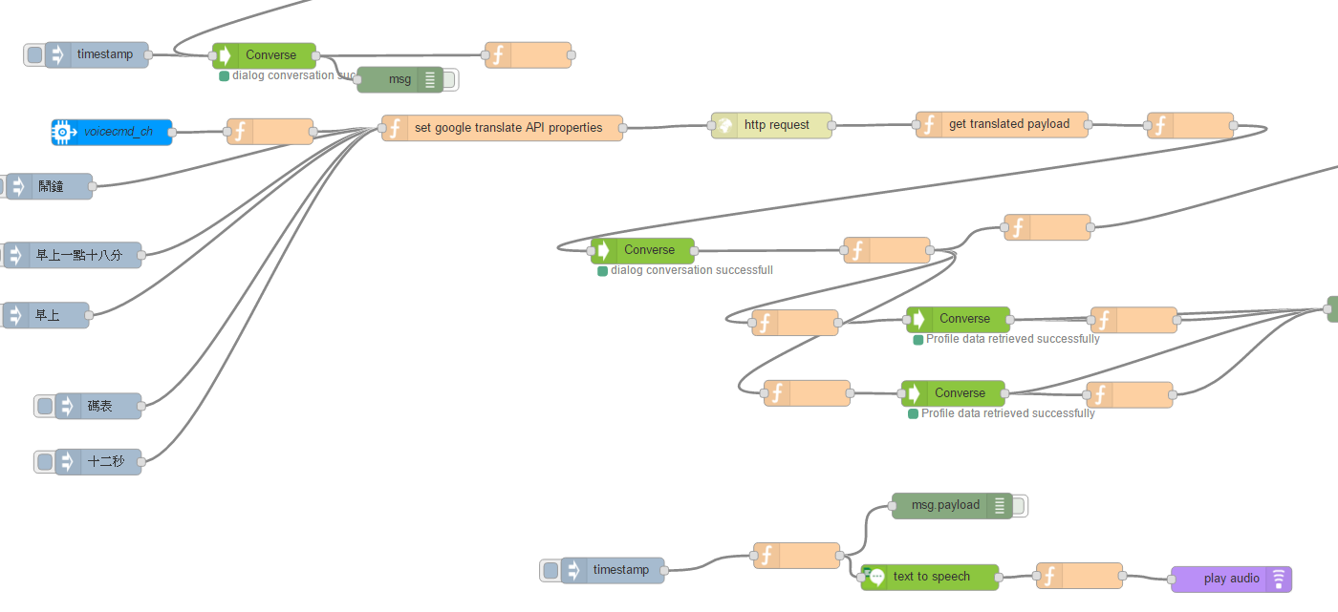
Implement on your real project

Slide 14
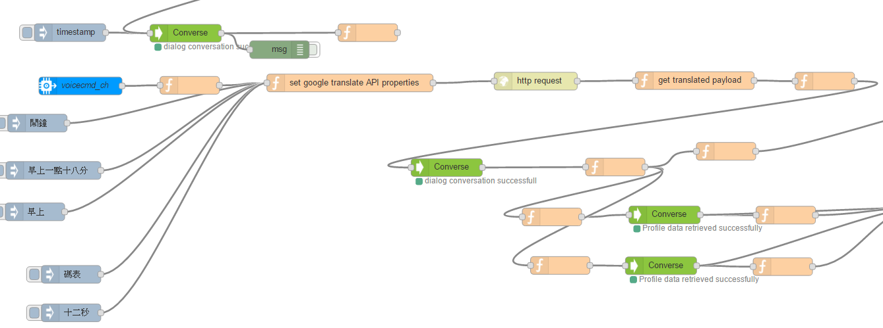
Implement on your real project
Conversation ID
trigger

Slide 15

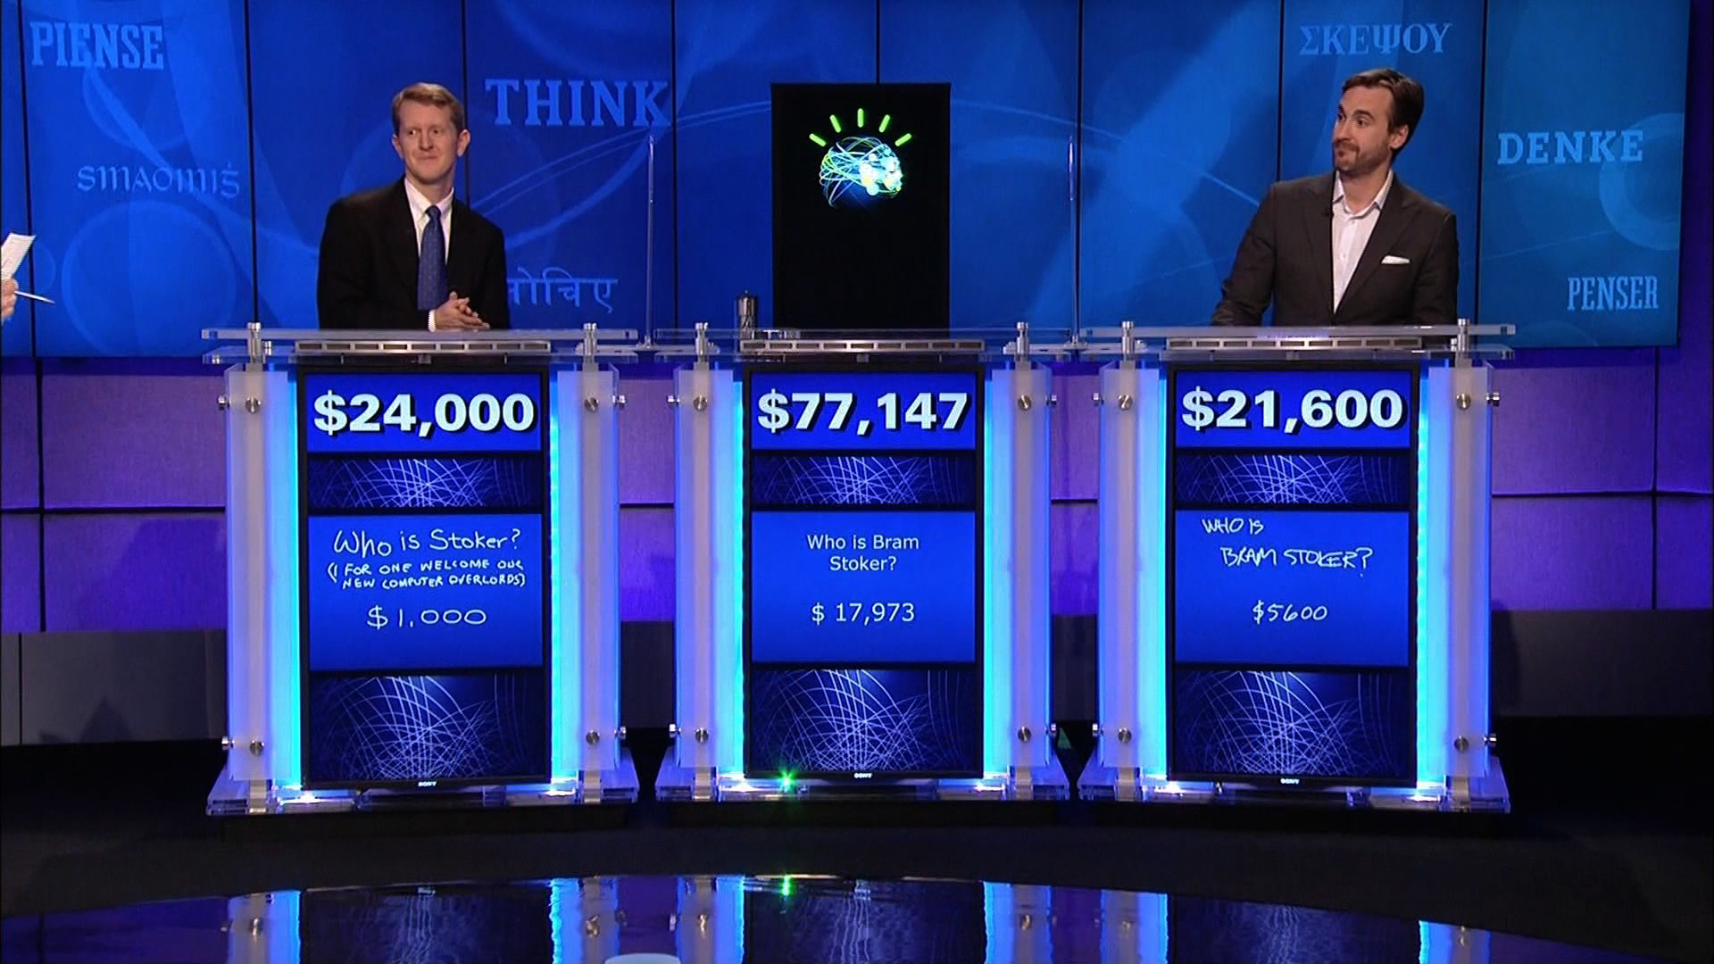
NLC

Slide 16
How to use?
Train your classifier
Test and enforce
Implement on your real project

Slide 17
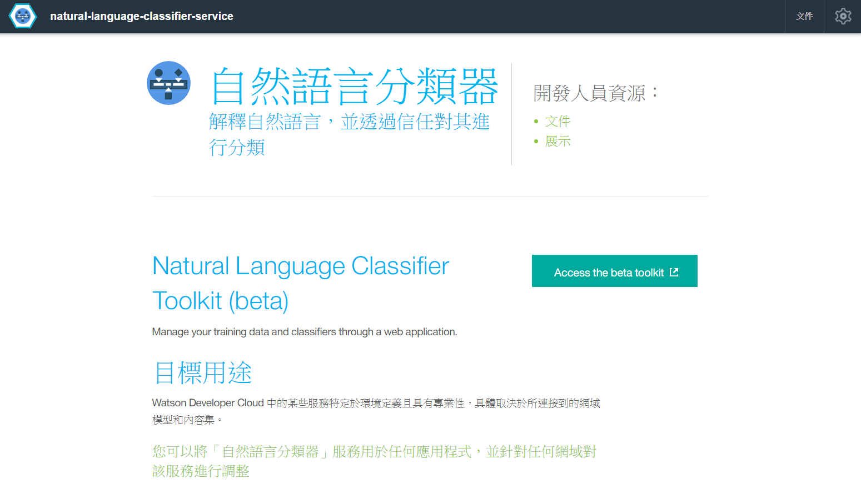
NLC

Slide 18
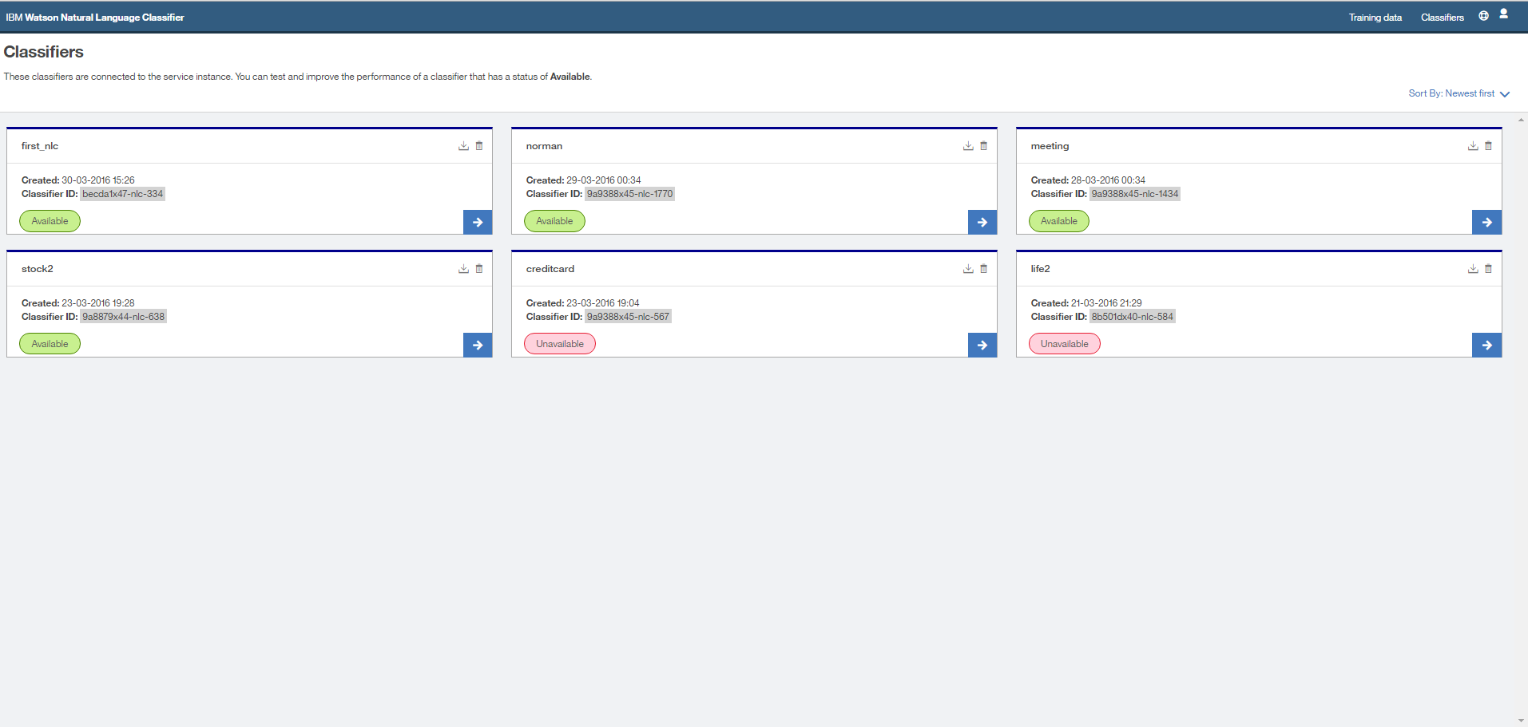
NLC

Slide 19
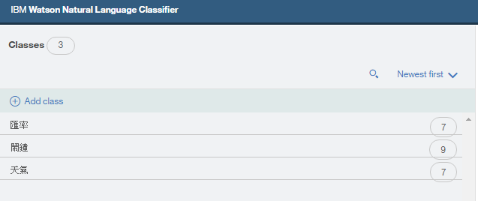
NLC

Slide 20
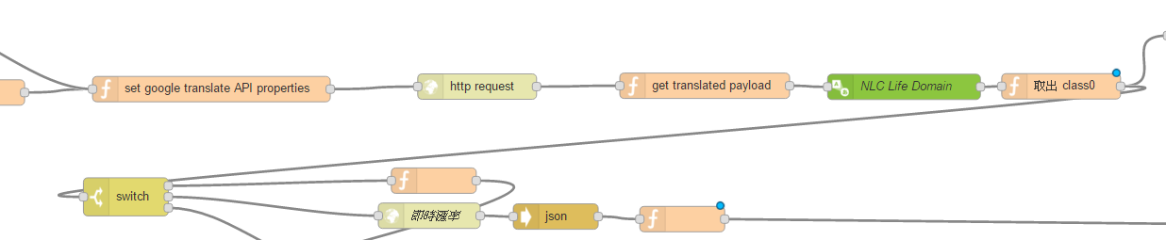
NLC

Slide 21
Combination
text
switch
NLC
trigger
Dialog
switch
Dialog

Slide 22
Combination
text
switch
trigger
Dialog
switch
NLC
Dialog

Slide 23
Combination
text
switch
NLC
trigger
Dialog
switch
Dialog
NLC

Slide 24
Thanks !

